Slide 1
Lecture 8
Recursion

Slide 2
Main Points
Define Recursion
  Advantages
  Disadvantages
The use of recursion
How Recursion works
  Tracing a recursive function
Examples

Slide 3
Recursion: A definition
A function that calls itself is named a recursive function or it is part of a cycle in the sequence of function calls
  You use recursion as an alternative to iteration: looping
Recursive algorithms require more time
  Avoid recursion when the size of the problem (n) grows bigger
Recursive algorithm waste much space:
    each recursive call requires the creation of an ‘Activation Record’ in the stack
    each activation record contains the following:
      parameters, local variables, return….
    Hence, if the depth of recursion is large the required space may be much significant!

Slide 4
Recursion:
Recursion vs iteration???
  Repetition
    Iteration: explicit loop
    Recursion: repeated function calls
  Termination
    Iteration: stops when the condition is False
    Recursion: stops when base case recognized
  Both can have infinite loops
  We can implement one with the other

Slide 5
Exercise 1
Let’s consider the example of calculating the factorial of an integer N
int factorial(int N){
int i,result=1;
for(i=1;i<=N;i++)
result=result*i;
return(result);
}
This definition is iterative. A repetitive function is defined as iterative when the definition involves only parameters and not the function itself.

Slide 6
How to use Recursion?
If N=4
  4!=4*3*2*1
  4!=4*3!
  3!=3*2!
  …
 Factorial(N)=
We notice that the calculation of factorial involves the use of factorial!
Recursion
1
If N=0
N*(N-1)!
If N>0

Slide 7
Designing Recursive Functions
If you were to examine all possible recursive functions, you would see that they all have two elements:
  each call either solves one part of the problem or it reduces the size of the problem.
  In the previous slide, the first statement solves a small piece of the problem: factorial(0) is 1. The second statement, on the other hand, reduces the size of the problem by recursively calling the factorial with (n-1)
The statement that “solves” the problem is known as the “Base Case”. The rest of the function is called the “General Case”.

Slide 8
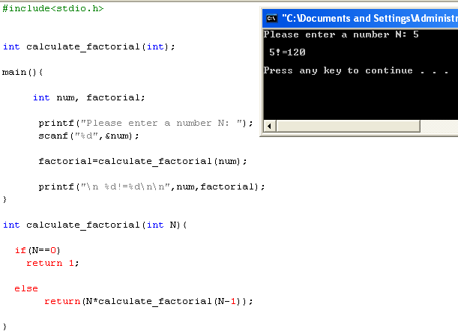
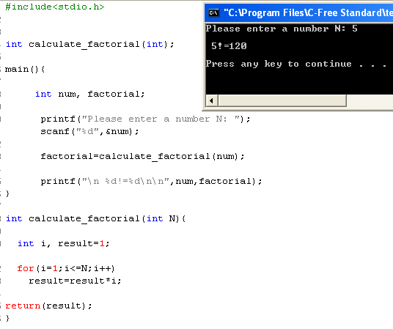
Recursion: Illustration

Slide 9
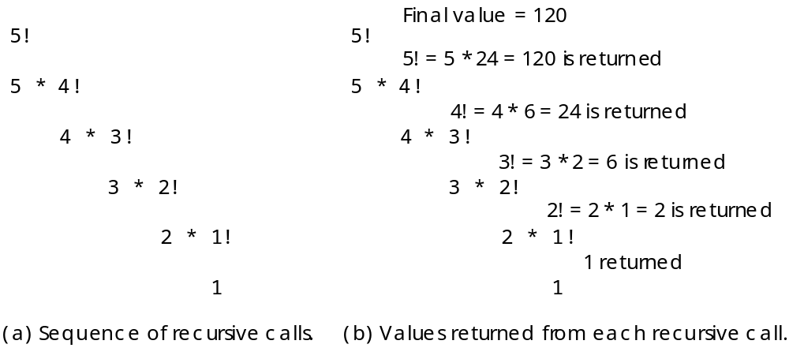
Back to factorial()
Let’s re-examine the factorial function

Slide 10
Explanation
Important  If you study carefully the figure in the slide before, you will note that the recursive solution for a problem involves a two-way process:
  1. we decompose the problem from the top to the bottom
  2. then we solve it from the bottom to the top.

Slide 11
Recursion: How to use it?
The Rules:
  1. Determine the base case
    Each recursive function must have a Base Case.
    Once the base case has been reached, the solution begins. We know one part of the answer and can return that part to the next statement
  2. Determine the general case.
  3. Combine the base case and general case into a function.
Logic:
  Each call must reduce the size of the problem and move it towards the base case.
  The base case, when reached, must terminate without a call to the recursive function; that is, it must execute a return.

Slide 12
Exercise 2
Write a recursive function ‘sum(int n)’
that calculates the sum of successive
integers starting at 1 and ending at n
[sum(n) = 1+2+…+n]
Remember!
Find a base case
General case
Combine the two into a function and apply

Slide 13
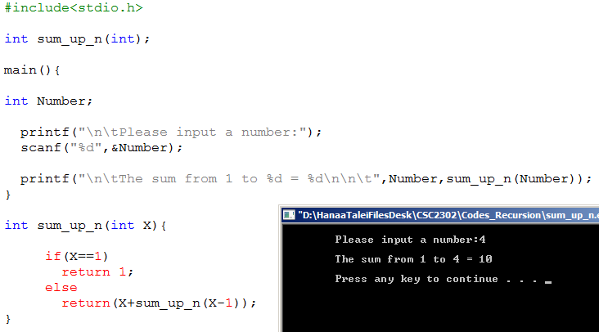
Solution

Slide 14
Exercise 3
Using a recursive function that solves the multiplication. i.e: function should take two input n, m and returns n*m

Slide 15
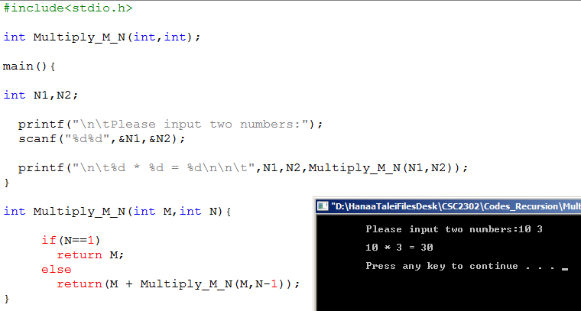
Solution

Slide 16
Exercise 4: Fibonacci numbers
Fibonacci numbers are a series of numbers in which each number is the sum of the previous two numbers:
  0, 1, 1, 2, 3, 5, 8, 13, 21, 34 , …..
To start, the series, we need to know the first two numbers. AS you can see from the above series, they are zero and one.
Hence:
  Base case?
  General case?

Slide 17
Fibonacci Numbers: Solution
int fib(int n) {
if (n == 0 || n == 1) // Base Case
return(n);
else // General Case
return(fib(n-1) + fib(n-2));
}
fib(5) = fib(4) + fib(3)
= fib(3) + fib(2) + fib(2) + fib(1)
= fib(2) + fib(1) + fib(1) + fib(0) + fib(1) + fib(0) + 1
= fib(1) + fib(0) +1 +1 +0 +1 +1
=1+ 0 + 1 + 1 + 0 + 1 + 1 = 5

Slide 18
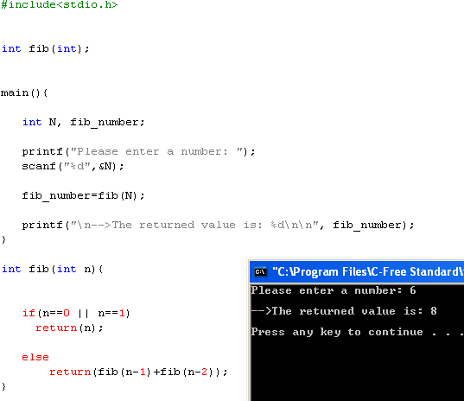
Fibonacci Numbers: Implementation

Slide 19
Exercise 5: Working with strings!
Define a recursive function that counts how many vowels are in a string!
  Discussion before implementation!

Slide 20
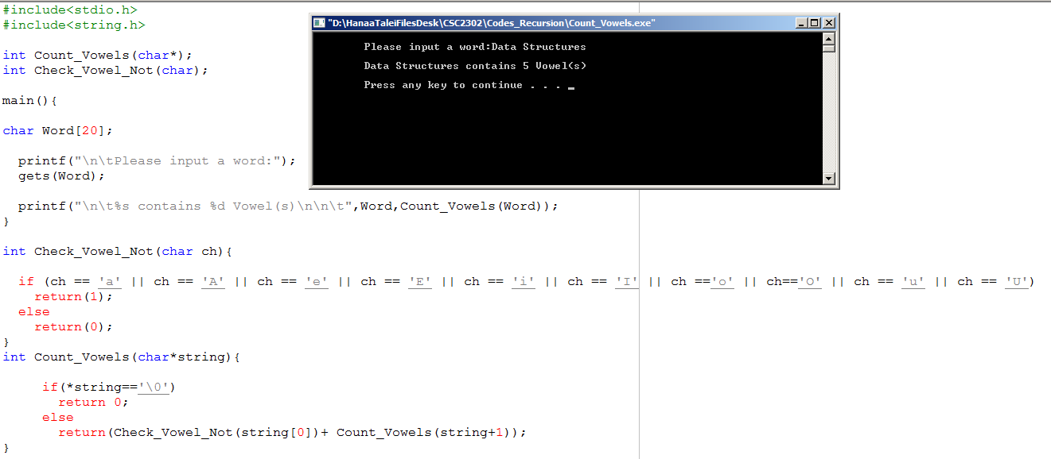
Solution1

Slide 21
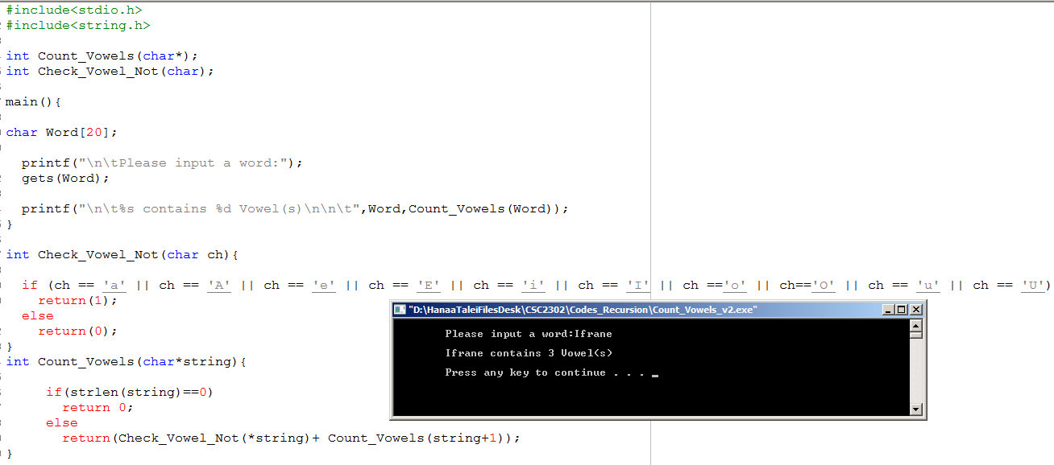

Another Solution

Slide 22
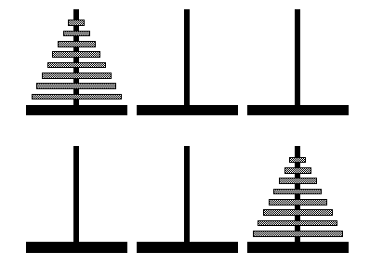
Exercise 6: Towers of Hanoi
Legend says that the world will come to its end when problem solved for 64 disks!!

Slide 23
Tower of Hanoi: Problem Requirements
  Three pegs A, B, C
  The puzzle begins with all rings placed in Peg A in such a manner no ring is resting over on a smaller
  All Rings have to be moved in the same order to Peg C
  At any time during the solution you can place rings on any of the three pegs with the following restrictions:
    You can only move the topmost ring on any peg
    You can move only one disk at a time

Slide 24
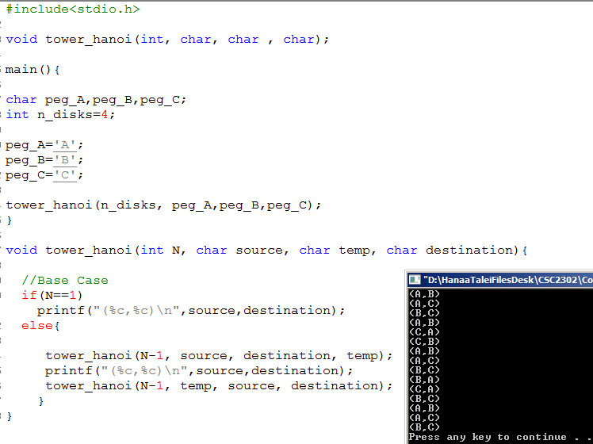
Tower of Hanoi: Illustration

Slide 25
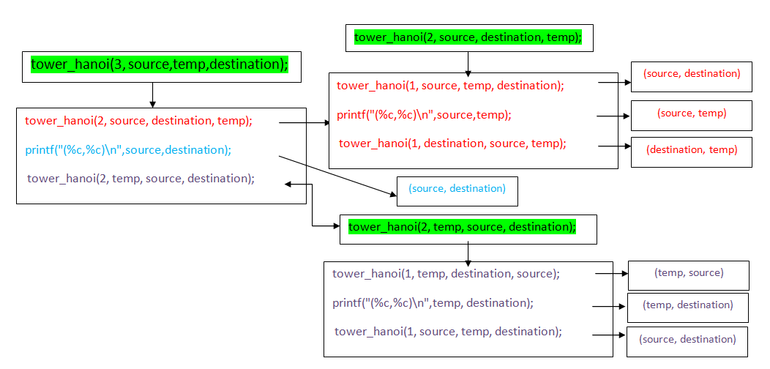
Tower Hanoi: Explanation
Moving 3 disks from A to C using B

Slide 26
Exercise 7:Recursion and a better Sorting algorithm (Big O): Merge Sort
A Sorting algorithm based on “divide and conquer!”
A much more efficient sorting technique than the ones we saw: bubble and selection sort
  Unlike bubble, selection and insertion sort, where Big-o is n², merge sort is O(n*log₂n)
    If n=10,000, n²=100,000,000, n*log n=40,000

Slide 27
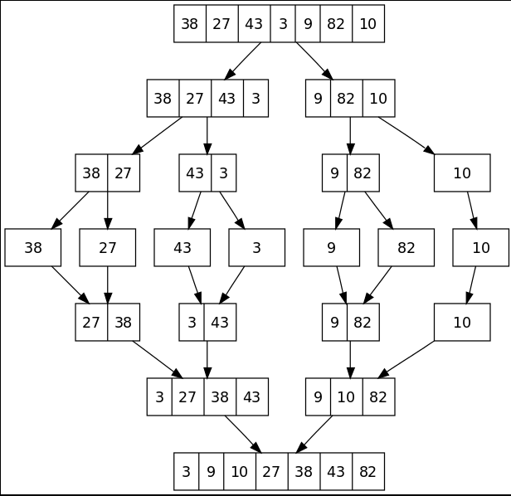
Merge Sort: understand how it works https://www.youtube.com/watch?v=GCae1WNvnZM

Slide 28
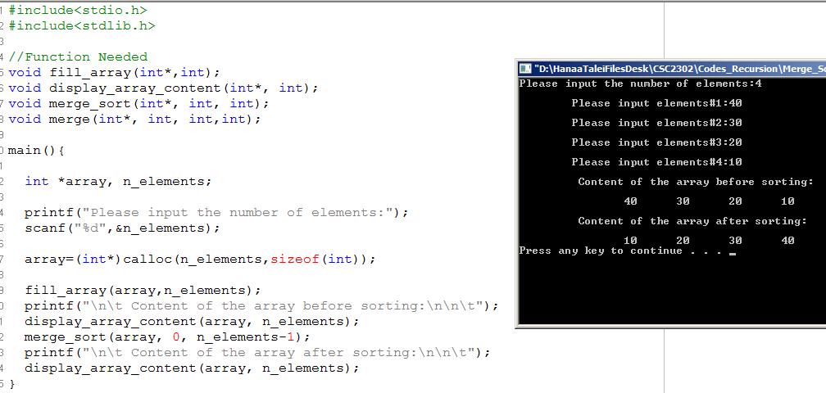
Merge Sort Illustration

Slide 29
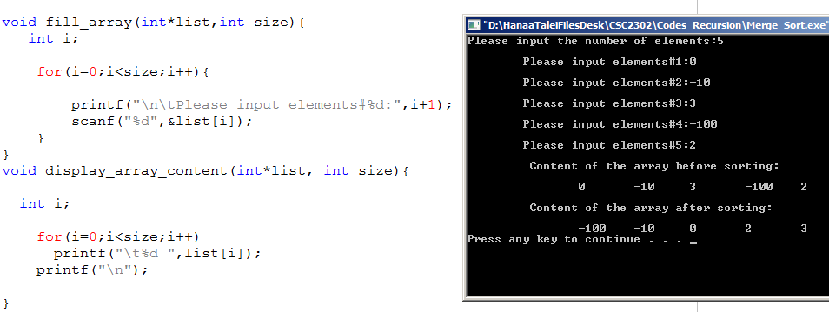
Merge Sort Illustration (Cont..)

Slide 30
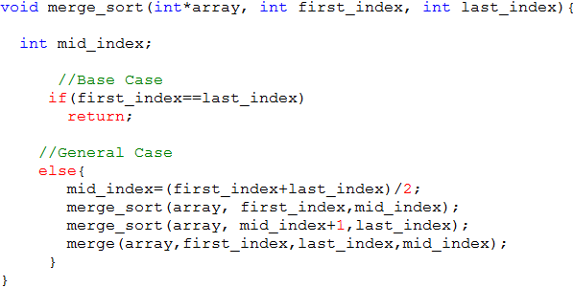
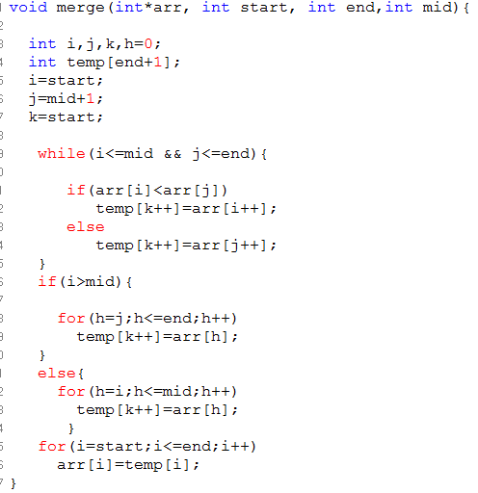

Slide 31
Recursion & Time Complexity
Recursive algorithms are known to be time consuming!
Conclusion:
  However, for many problems the recursive solution is more natural than the alternative non-recursive or iterative solution
  Avoid recursion when the size of the problem (n) grows bigger

Slide 32
Recursion: Conclusion
  All ‘Recursive’ functions have a corresponding ‘Iterative’ solution
   Recursive algorithms require more time
    Remember the example of Tower of Hanoi
   Recursive algorithm waste much space:
    each recursive call requires the creation of an ‘Activation Record’ in the stack
    each activation record contains the following:
      parameters, local variables, return address, stack link
    Hence, if the depth of recursion is large the required space may be much significant!

